Slide 1
RCT Oral Project Update
By Daniel, Naveen, Sam, and Thomas

Slide 2
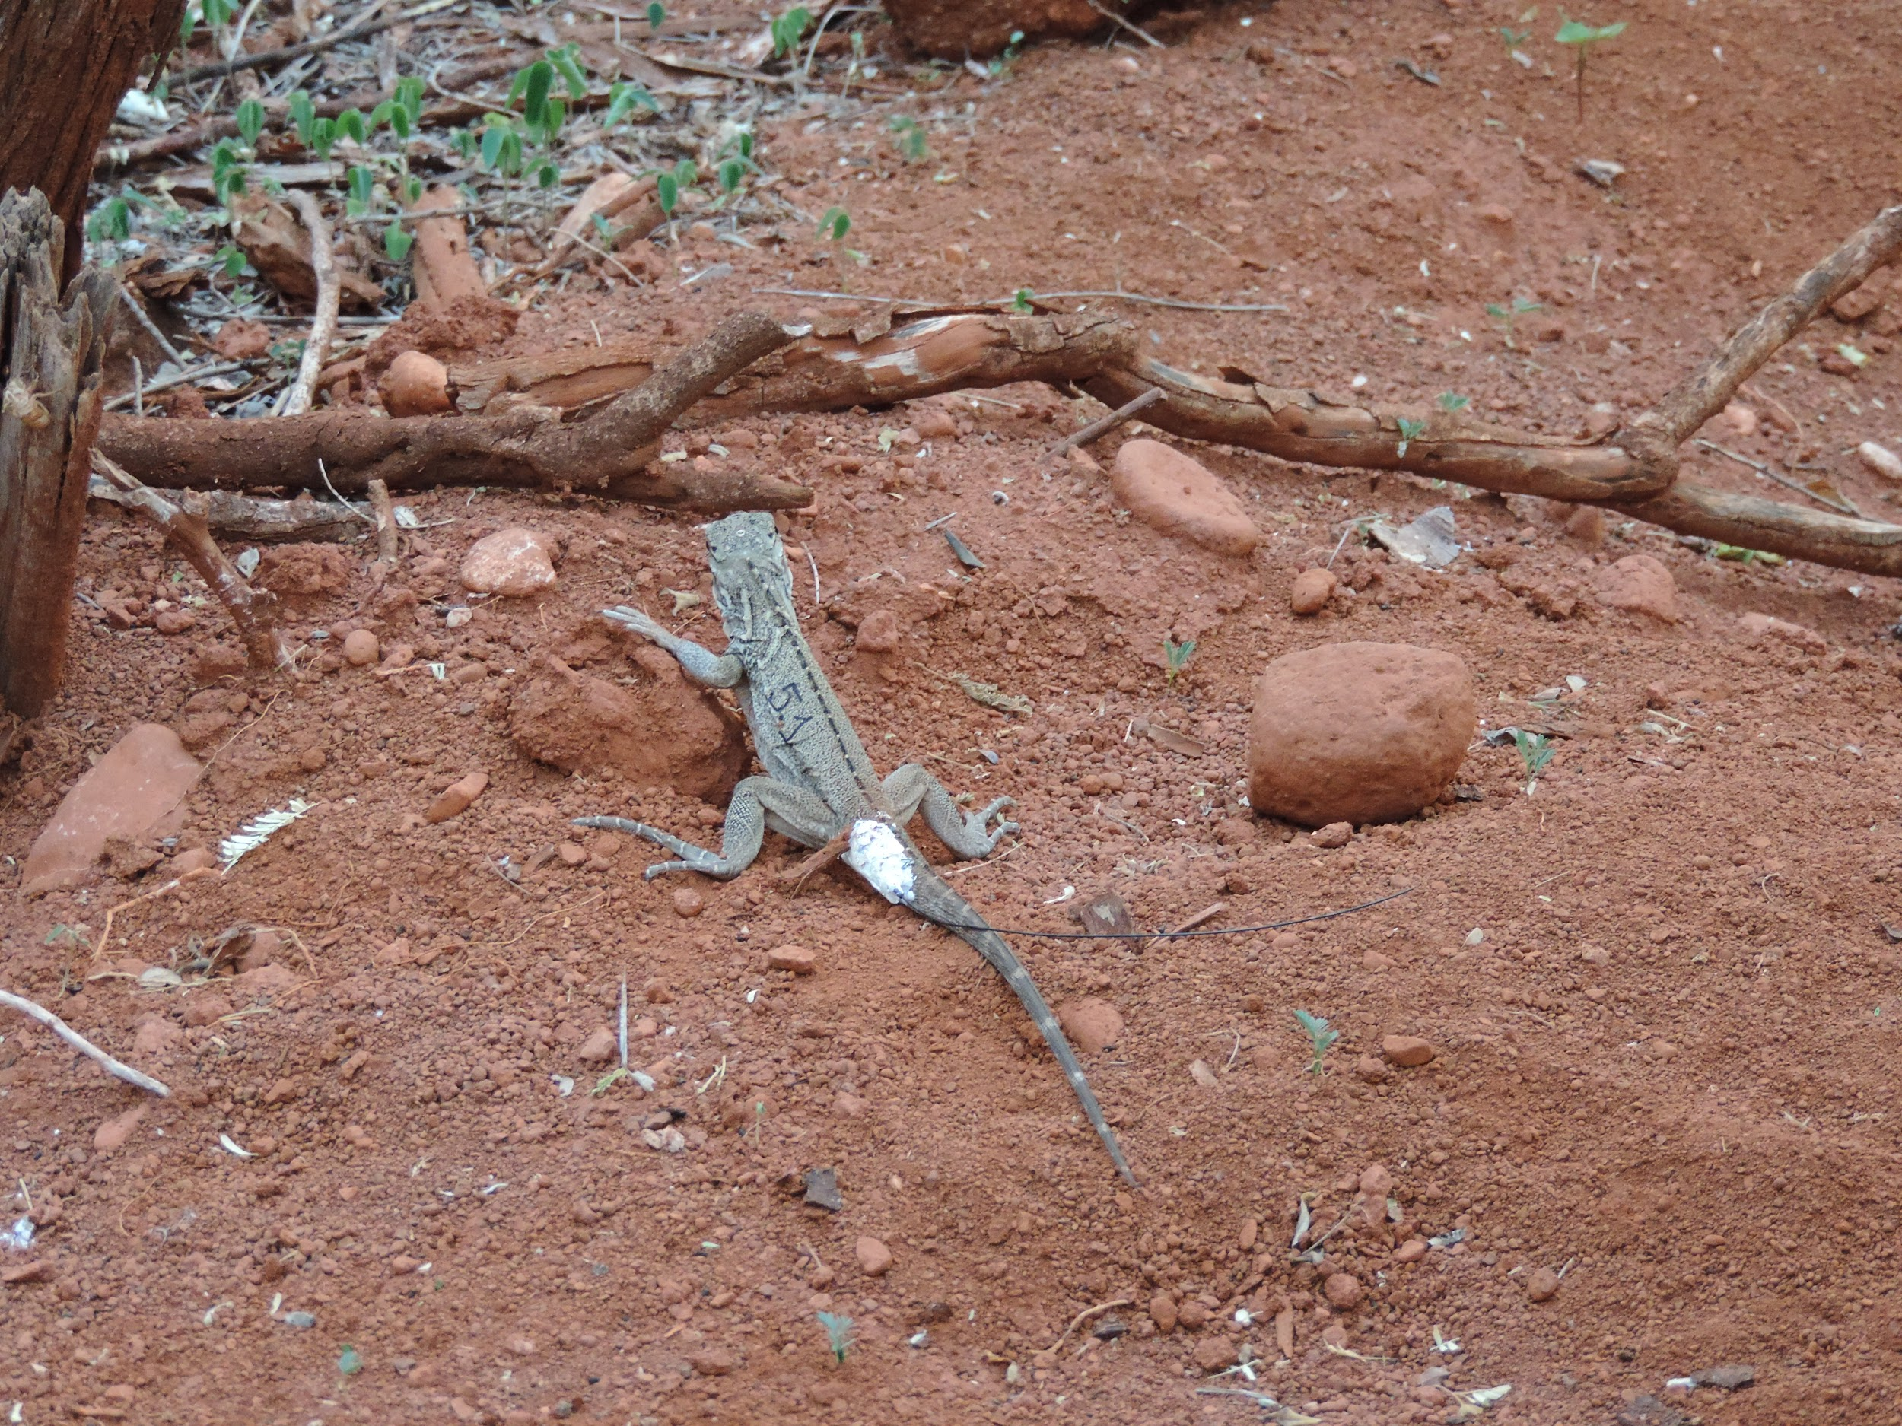
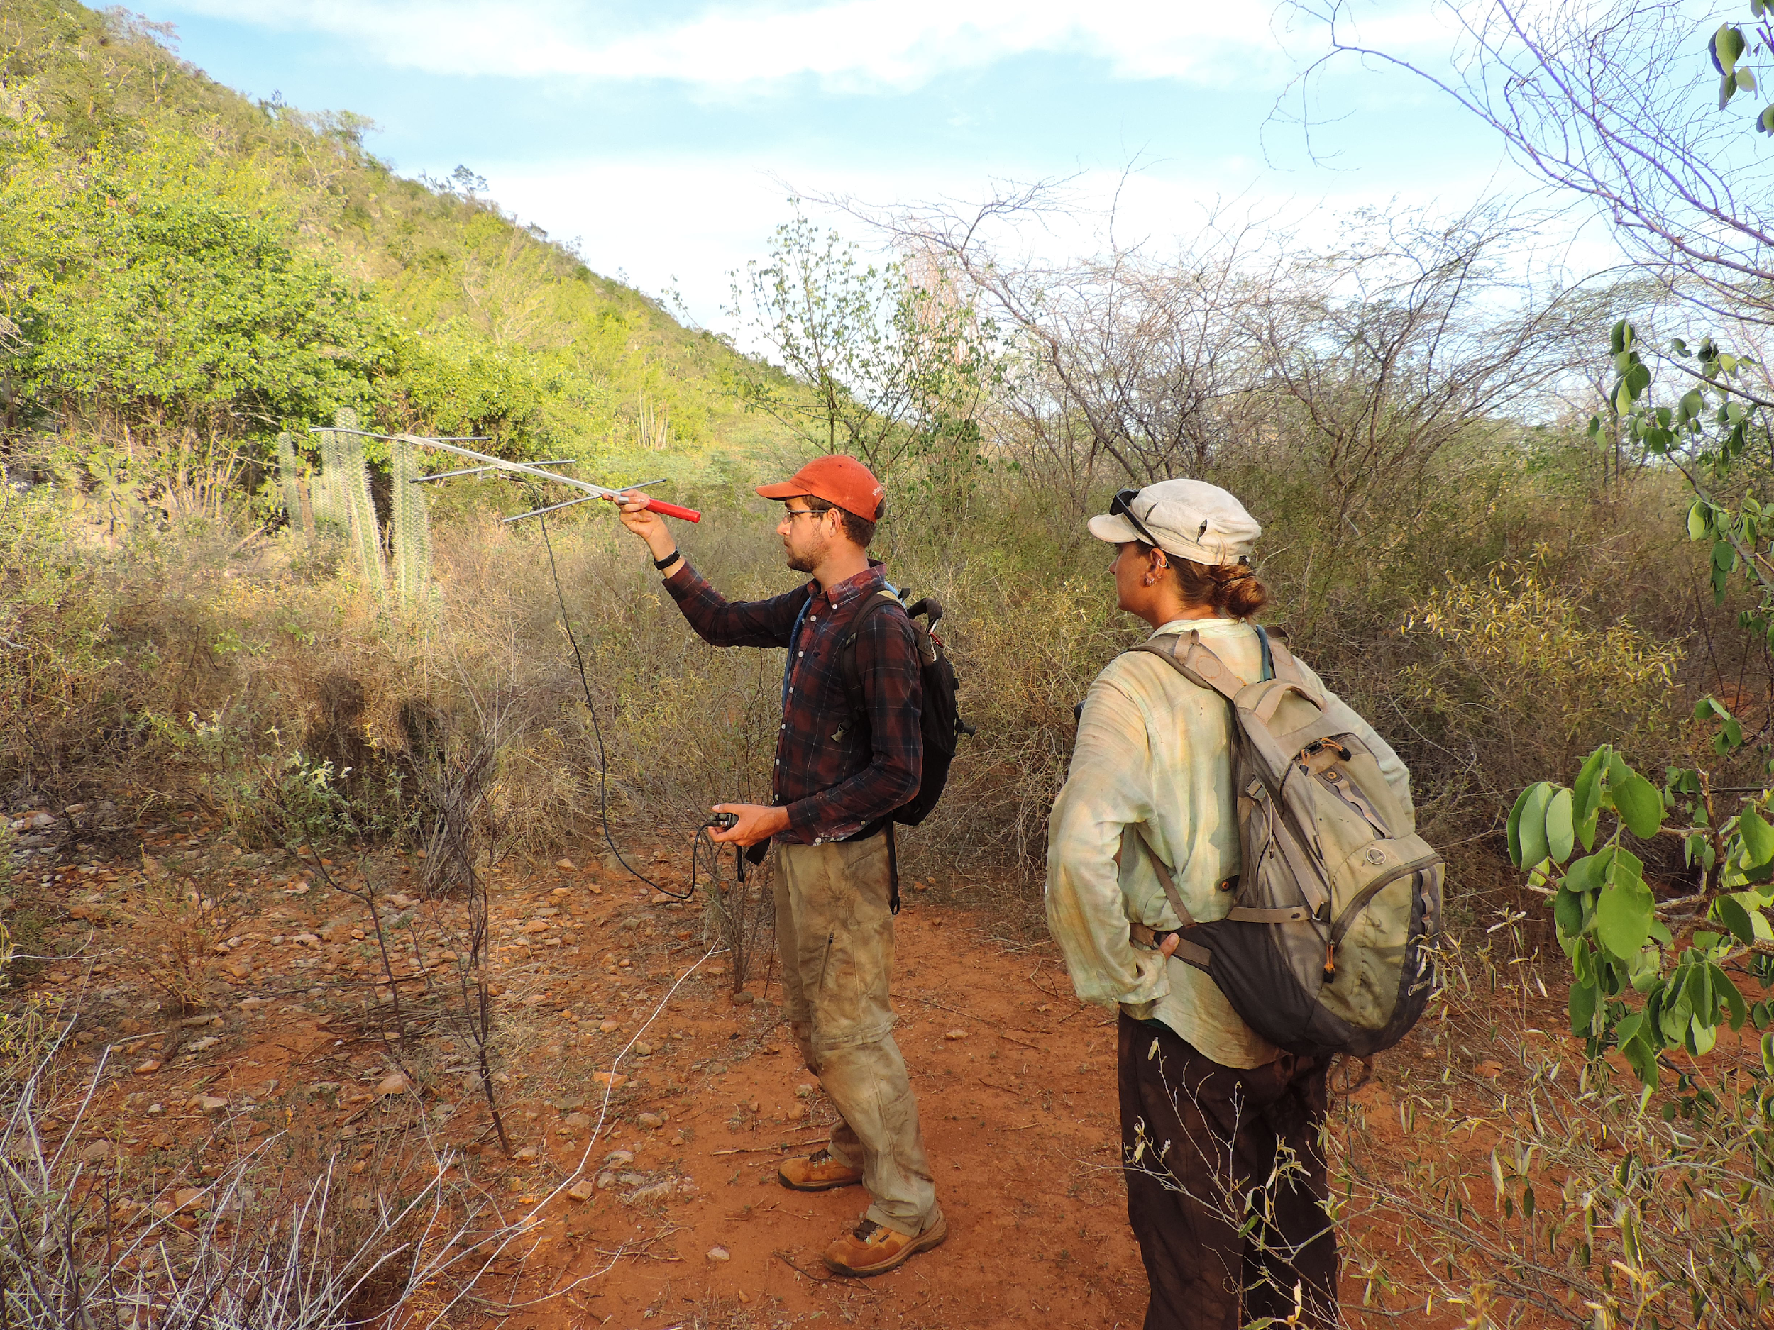
Overview
Want to track animals tagged with a radio collar using a quadcoptor
Ongoing project for more than a couple years
Notes:
Go over motivation again about avoiding bad terrain

Slide 3
Milestones
Radio Collar Emulator
Swapped recording radio collar milestone with transmitting a similar waveform first
On track for the other milestones
Notes:
Milestone swapping made more sense for familiarizing ourselves with gnuradio. Starting more broad by getting waveforms close by inspection, then actually number crunching.

Slide 4
Milestones
Radio collar being emulated
**Some short video or picture here**
Notes:
Should show radio collar pings.

Slide 5
Sprint
Radio collar being emulated
**Some short video or picture here**
Notes:
Should show radio collar pings.

